Slide 1
Cardiac Screening in Athletes A Brief Review
Sara Filmalter, MD
Mayo Clinic Florida
Jacksonville Sports Medicine Symposium
April 12, 2014

Slide 2
Disclosures….

Slide 3
Cardiac Disease Incidence
Hypertrophic cardiomyopathy – 1:500
Long QT Syndrome – 1:7000
Marfan’s Syndrome – 1:5000
Cardiac disease prevalence of 0.3% in general athletic populations
~1:333
SCA in athletes: Approx 1:200,000

Slide 4
Incidence of SCA in Young Athletes
About 2000 patients under 25 die annually from SCA
Athletes + non-athletes
Likelihood of SCA due to underlying CV disease increases with athletic participation
Approximately 2.5 times greater risk
NCAA
5 year period, Jan 2004-Dec 2008
1/43,770 participants per year
56% of the medical deaths
75% of sudden deaths during exertion

Slide 5
US National Registry of Sudden Death in Athletes
Minneapolis Heart Institute Foundation
27 year period
Athletes 8-39 years old
1,866 sudden deaths
56% confirmed or probable cardiovascular etiologies
Average CV deaths/year = 66 (50-76)
0.61/100,000 person-years

Slide 6
Maron BJ et al. Circ 2009;119:1085-92.

Slide 7
Etiologies of SCD in Athletes
Structural/Functional
Electrical
Hypertrophic cardiomyopathy
Coronary artery anomolies
Arrhythmogenic right ventricular cardiomyopathy
Dilated cardiomyopathy
Aortic rupture/Marfan’s
LV non-compaction
Myocarditis
Coronary artery disease
Congenital QT syndromes
Catecholaminergic polymorphic ventricular tachycardia
Brugada syndrome
Wolff-Parkinson-White
Complete heart block
Supraventricular tachycardias
Commotio cordis*

Slide 8
Most Common Causes of SCD in the U.S.
Maron BJ et al. Circ 2009;119:1085-92.

Slide 9
Signs and Symptoms?
1996 review of 9 studies
Preceding symptoms or family premature, unexplained death in 25-61%
Most often dizziness, chest pain, syncope, palpitations, or dyspnea
Exertion related in 8-33%
Another study of 15-34 year olds (n=162)
Symptoms: 92
Family History: 26

Slide 10
Current Practices
High School (2005)
81% of states have adequate questionnaires
≥9 of 12 AHA-recommended components
NCAA Division I (2012)
47% of responding schools use NICS
42% use ECG (half of which also use ECHO)
NCAA (2012)
224 college team physicians
78% using recommended AHA screening
30% of division I schools using ECG and/or ECHO

Slide 11
AHA Consensus Panel Recommendations for PPE
Family History
1. Premature sudden death in the family
2. Heart disease in surviving relatives
Personal History
3. History of a heart murmur
4. Systemic hypertension
5. Fatigability
6. Syncope
7. Exertional dyspnea
8. Exertional chest pain
Physical Exam
9. Heart murmur (supine, sitting, standing)
10. Femoral pulses
11. Stigmata of Marfan Syndrome
12. Blood pressure measurement

Slide 12
Barriers to Mandatory Screening
Many athletes
5-18y/o organized sports: 35 million
High School: >7.7 million
NCAA: >400K
Only athletes?
75 million children under 18
Limited access
Lack of medical oversight
Liability considerations (precedent vs. civil/criminal)
False positives
Cost/efficiency considerations

Slide 13
BUT....

Slide 14
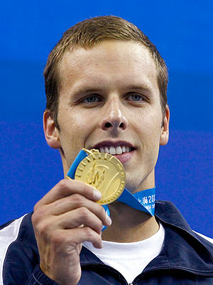
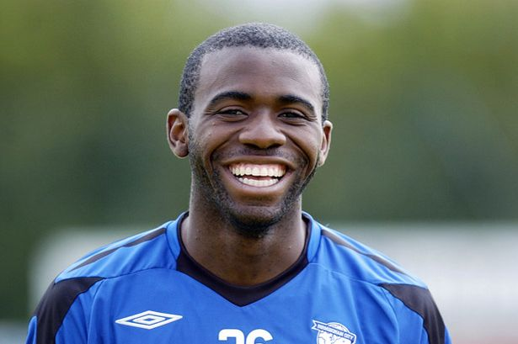
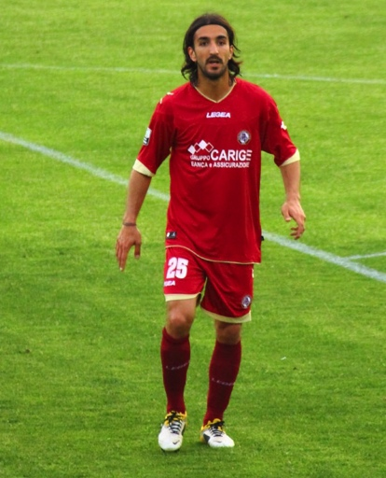
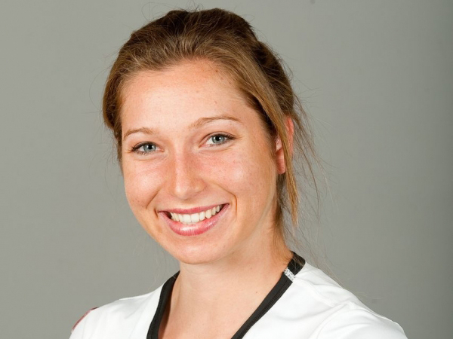
False Negatives

Slide 15
AED’s in Sudden Cardiac Arrest
2045 high schools over 2 years
Mean enrollment 963 students
59 cases of confirmed SCA
Student-athletes – 18
Other students – 8
Athletic officials – 4
Coaches – 3
Visitors/Spectators/School staff – 26
Athletic facilities: 66%
During games – 20, during practice – 19
Basketball (13), football (9), baseball, track and field, ice hockey, soccer, softball, cheerleading, cross country, lacrosse, swimming, wrestling
Drezner JA, et al. BJSM 2013

Slide 16
AED’s in Sudden Cardiac Arrest
93% witnessed, 100% student-athletes
Responders: administration, ATC’s, visitors, school nurses, coaches, teachers
EMS on-site in 3 cases
CPR provided in 92% of the cases
AED brought to scene: 100%
From school: 70%
Offsite EMS: 25%, Onsite EMS: 5%
Application in 85%, shock in 66%
Drezner JA, et al. BJSM 2013

Slide 17
AED’s in Sudden Cardiac Arrest
Survival
Overall: 71%
When shock delivered onsite: 87%
AED onsite: 80%
AED brought by offsite EMS: 50%
Schools with EAP: 79%
Schools without EAP: 44%
“The single greatest factor affecting survival from
SCA is the time interval from cardiac arrest to
defibrillation.”

Slide 19
Thank you!

Slide 20
References
National Federation of State High School Associations. http://www.nfhs.org/content.aspx?id=9628. Accessed Apr 4, 2014.
NCAA. http://www.ncaa.com/news/ncaa/article/2011-11-02/ncaa-participation-rates-going. Accessed Apr 4, 2014.
Maron, B, et al. Sudden Deaths in Young Competitive Athletes. Circ 2009; 119(8):1085-1092.
Harmon KG, et al. Incidence of sudden cardiac death in National Collegiate Athletic Association athletes. Circ 2011; 123(15):1594-600.
Asplund CA, Asif IM. Cardiovascular Preparticipation Screening Practices of College Team Physicians. Clin J Sport Med Jan 21, 2014. Epub ahead of print.
Policy Statement: Pediatric Sudden Cardiac Arrest. Pediatrics 2012; 129:e1094-e1102.
Drezner JA, et al. Outcomes from sudden cardiac arrest in US high schools: a 2-year prospective study from the National Registry for AED Use in Sports. Br J Sport Med 2013;47:1179-1183.
Maron BJ, et al. Recommendations and Considerations Related to Preparticipation Screening for Cardiovascular Abnormalities in Competitive Athletes: 2007 Update. Circ 2007;115:1643-55.

